Slide 1
Deep Learning in NLP
Many slides adapted from Richard Socher, Tom Mitchell

Slide 44
Neural Network Language Models

Slide 45
Review
Deep Learning
Learning Representations of Inputs
Neural Networks
Layers of Logistic Regression
Can represent any nonlinear function (with a large enough network)
Training with backpropagation
Recent breakthroughs in predictive tasks
Speech Recognition
Object Recognition (computer vision)

Slide 46
Q: How to model sequences with neural Networks?
Fixed number of inputs.

Slide 47
How about just predicting the next word in the input?
Q: what about just predicting the next word?
From the context?
No longer a language model
Word2Vec!

Slide 48
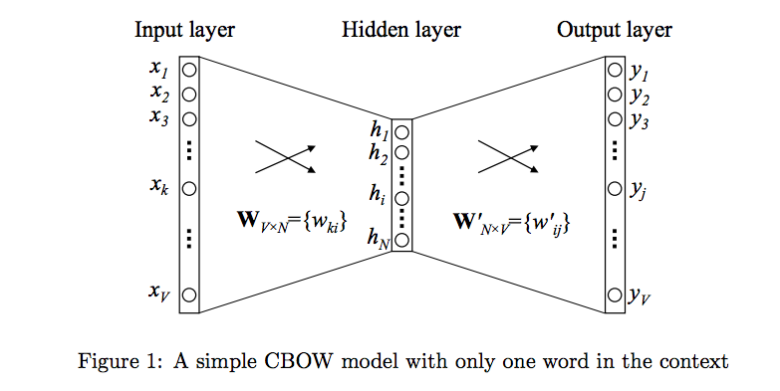
Word2vec
Learn continuous word embedding for each word
Each word represented by a vector

Slide 49
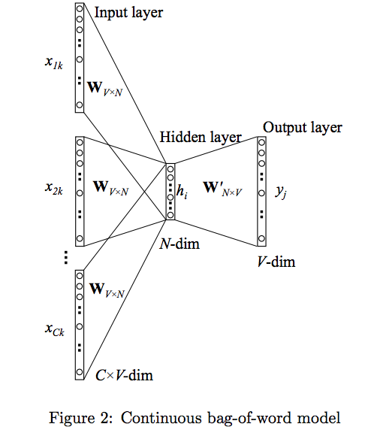
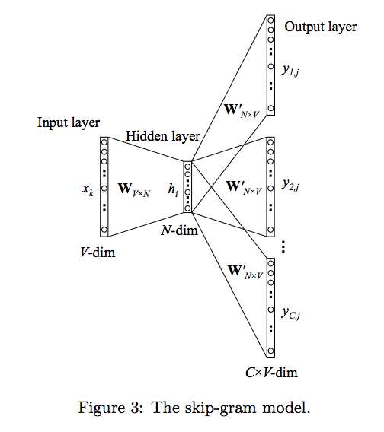
Using more than one word of context

Slide 50
Word2Vec: fast to train
Word2Vec is a fairly simple model,
But Can efficiently train word vectors on really big corpora
This is probably the main advantage of Word2vec over other approaches...
Principal Component Analysis
Recurrent Neural Network Language Models

Slide 51
queen
king
woman
man
VEC(king) + VEC(woman) - VEC(man) = ?

Slide 52
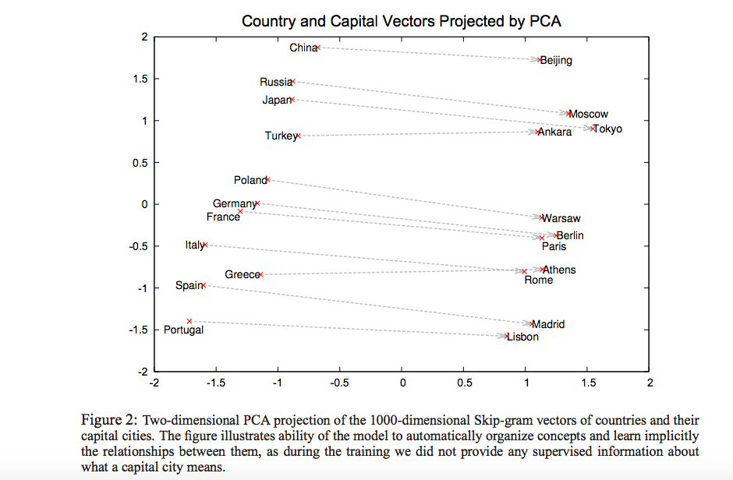

Slide 53

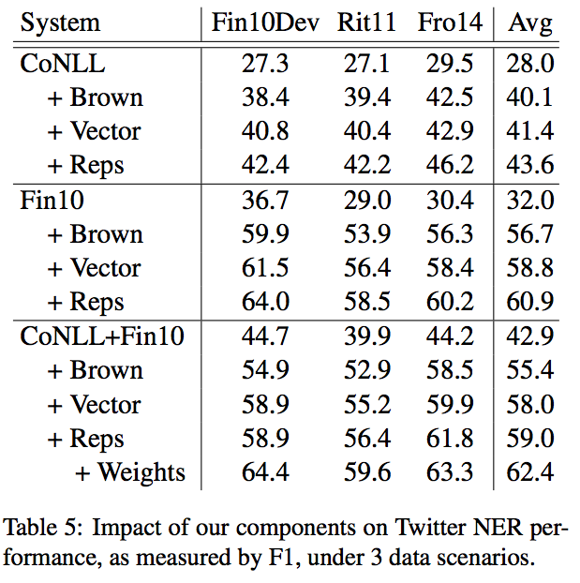


Slide 59
Recurrent Neural Network Language Models
…
…
…
…
…
…
…
…
…
…

Slide 62
Training RNN language models
It’s just a neural network!
With a slightly different / more complicated structure
Straightforward to compute gradients of all parameters wrt. Outputs

Slide 63
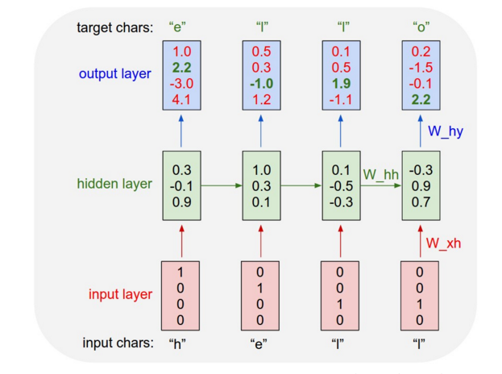

Slide 64
More complicated stuff…
Technical Problem: vanishing / exploding gradients
(sort of) Solutions: LSTM units or GRUs
Encoder-decoder RNN
Sequence-to-sequence
Machine translation
Conversation generation
Image captioning
These are all just end-to-end neural networks trained with backpropagation!

Slide 65
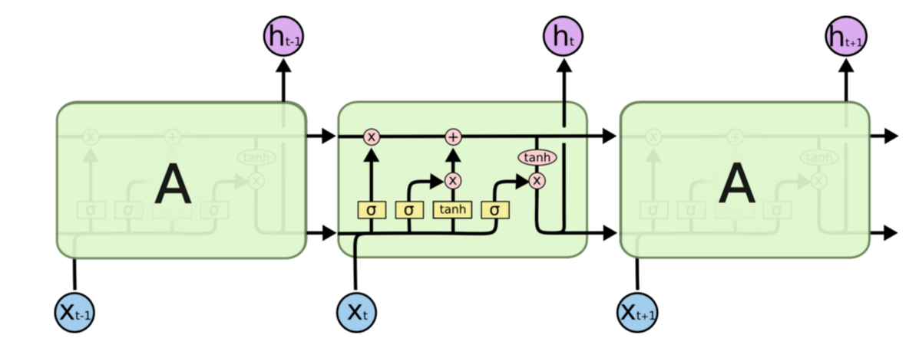
LSTM Unit…

Slide 66
GRU Unit…

Slide 67
Generating text from an RNN LM
…
…
…
…
…
…
…
…
…
…

Slide 68
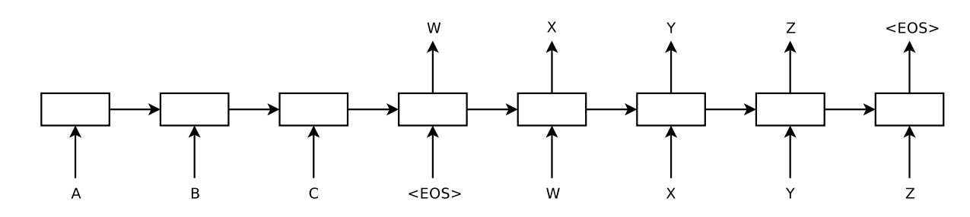
Neural Translation Models (sequence to sequence)

Slide 69
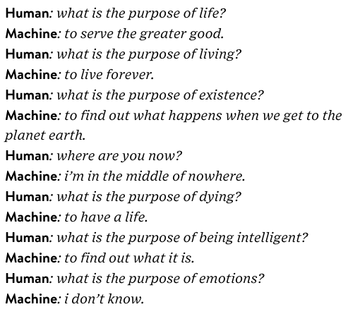
Conversation Generation

Slide 70

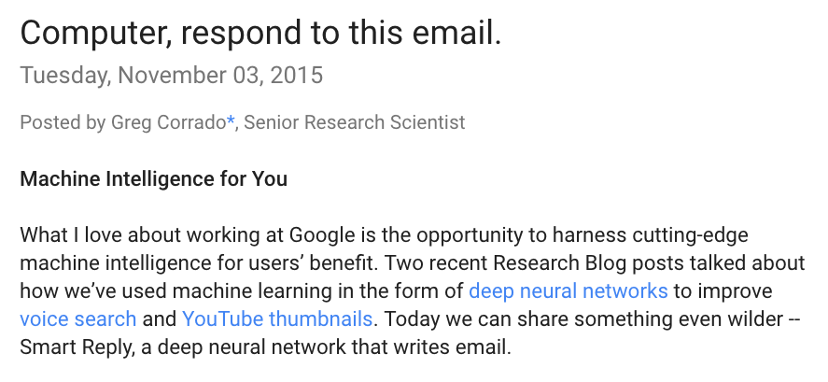

Slide 73


Slide 75
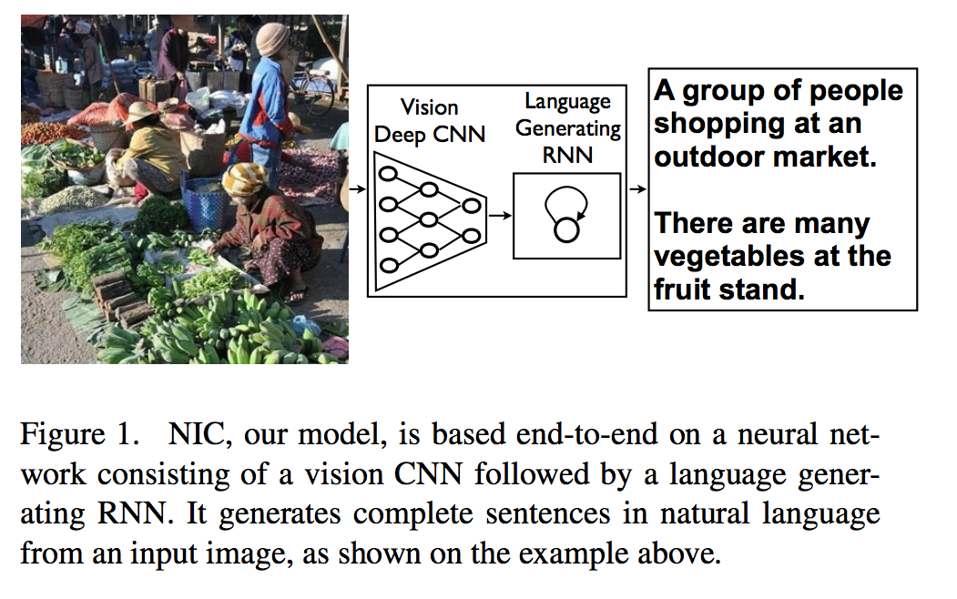

Slide 83
Summary
Deep learning is a popular area in machine learning recently
Very successful in speech recognition and computer vision
Becoming very popular in NLP these days
Main motivation:
Learn feature representations from data
Alternative to hand-engineered features
Neural networks:
Primary deep learning approach
Layers of logistic regressions – can directly calculate gradients from outputs
Nonlinear decision boundaries

